Slide 1
JUMIA SALES ANALYSIS PRESENTER: JUDETADEUS MASIKA

Slide 2
Descriptive Statistics
The average current price of products is 1303.
The average old price of products is 2055
The average percentage discount is 39%
The average rating star for the products is 3.889

Slide 3
Trend Analysis
The relationship between discount percentage and number of reviews has no trend, it’s only prone to relationship.

Slide 4
Trend Analysis
The relationship between rating and number of reviews has no trend, it’s only prone to relationship.

Slide 5
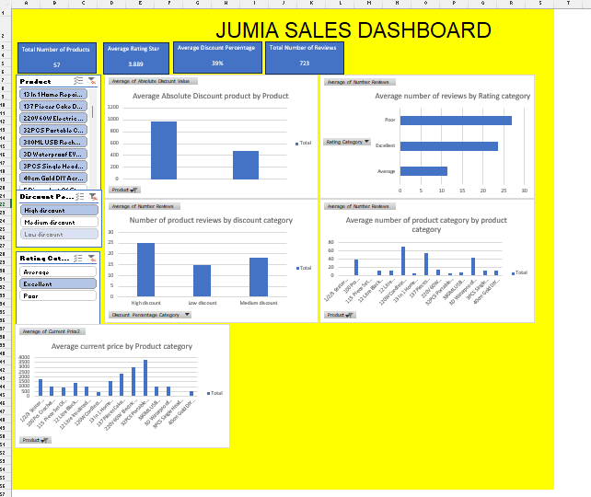
Sales Dashboard
The dashboard is interactive. The relation between product categories and rating, discount percentage etc. is unclear for this data.

